Slide 1
Chapter 14 Key Management and Distribution

Slide 2
Key Management and Distribution
Symmetric schemes require both parties to share a common secret key.
Issue is how to securely distribute this key whilst protecting it from others.
Frequent key changes are usually desirable to limit the amount of data compromised if an attacker learns the key.
Often secure system failures are due to a break in the key distribution scheme.
Notes:
For symmetric encryption to work, the two parties to an exchange must share the same key, and that key must be protected from access by others. Furthermore, frequent key changes are usually desirable to limit the amount of data compromised if an attacker learns the key. This is one of the most critical areas in security systems - on many occasions systems have been broken, not because of a poor encryption algorithm, but because of poor key selection or management. It is absolutely critical to get this right!

Slide 3
Symmetric Key Distribution
Given parties A and B, key distribution can be achieved in several ways:
A can select a key and physically deliver it to B
A third party can select the key and physically deliver it to A and B
If A and B have previously and recently used a key, one party can transmit the new key to the other, encrypted using the old key
If A and B each has an encrypted connection to a third-party C, C can deliver a key on the encrypted links to A and B
Notes:
For two parties A and B, key distribution can be achieved in a number of ways, as
follows:
1. A can select a key and physically deliver it to B.
2. A third party can select the key and physically deliver it to A and B.
3. If A and B have previously and recently used a key, one party can transmit the
new key to the other, encrypted using the old key.
4. If A and B each has an encrypted connection to a third party C, C can deliver
a key on the encrypted links to A and B.
Options 1 and 2 call for manual delivery of a key. For link encryption, this
is a reasonable requirement, because each link encryption device is going to be
exchanging data only with its partner on the other end of the link. However, for
end-to-end encryption over a network, manual delivery is awkward. In a distributed
system, any given host or terminal may need to engage in exchanges with
many other hosts and terminals over time. Thus, each device needs a number of
keys supplied dynamically. The problem is especially difficult in a wide-area distributed
system.

Slide 4
Key Hierarchy
typically have a hierarchy of keys
session key
temporary key
used for encryption of data between users
for one logical session then discarded
master key
used to encrypt session keys
shared by user & key distribution center
Notes:
For end-to-end encryption, some variation on option 4 has been widely adopted. In this scheme, a key distribution center is responsible for distributing keys to pairs of users (hosts, processes, applications) as needed. Each user must share a unique key with the key distribution center for purposes of key distribution. The use of a key distribution center is based on the use of a hierarchy of keys. At a minimum, two levels of keys are used: a session key, used for the duration of a logical connection; and a master key shared by the key distribution center and an end system or user and used to encrypt the session key.

Slide 5
Symmetric Key Distribution Using Public Keys
public key cryptosystems are inefficient
so almost never use for direct data encryption because symmetric key cryptosystems are much faster.
rather public key cryptosystems are used to encrypt secret keys for distribution.
Notes:
Because of the inefficiency of public key cryptosystems, they are almost never used for the direct encryption of sizable block of data, but are limited to relatively small blocks. One of the most important uses of a public key cryptosystem is to encrypt secret keys for distribution. We see many specific examples of this later in the text.

Slide 6
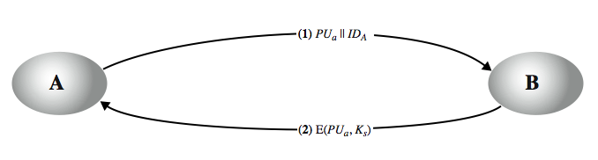
Simple Secret Key Distribution
Merkle proposed this very simple scheme
allows secure communications
no keys before/after exist
What is the problem in this simple scheme?
Notes:
An extremely simple scheme was put forward by Merkle from Stallings Figure 14.7. If A wishes to communicate with B, the following procedure is employed:
A generates a public/private key pair {PUa, PRa} and transmits a message to B consisting of PUa and an identifier of A, IDA.
B generates a secret key, Ks, and transmits it to A, encrypted with A's public key.
A computes D(PRa, E(PUa, Ks)) to recover the secret key. Because only A can decrypt the message, only A and B will know the identity of Ks.
A discards PUa and PRa and B discards PUa.
A and B can now securely communicate using conventional encryption and the session key Ks. At the completion of the exchange, both A and B discard Ks. Despite its simplicity, this is an attractive protocol. No keys exist before the start of the communication and none exist after the completion of communication. Thus, the risk of compromise of the keys is minimal. At the same time, the communication is secure from eavesdropping.

Slide 7
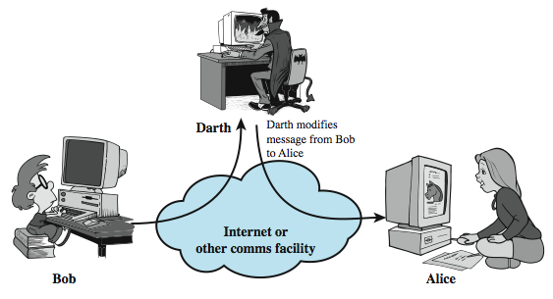
Man-in-the-Middle Attack
This very simple scheme is vulnerable to an active man-in-the-middle attack
Notes:
The protocol depicted in Figure 14.7 is insecure against an adversary who can intercept messages and then either relay the intercepted message or substitute another message (see Stallings Figure 1.3c). Such an attack is known as a man-in-the-middle attack. In this case, if an adversary, E, has control of the intervening communication channel, then E can compromise the communication in the following fashion without being detected:
A generates a public/private key pair {PUa, PRa} and transmits a message intended for B consisting of PUa and an identifier of A, IDA.
E intercepts the message, creates its own public/private key pair {PUe, PRe} and transmits PUe || IDA to B.
B generates a secret key, Ks, and transmits E(PUe, Ks).
E intercepts the message and learns Ks by computing D(PRe, E(PUe, Ks)).
E transmits E(PUa, Ks) to A.
The result is that both A and B know Ks and are unaware that Ks has also been revealed to E. A and B can now exchange messages using Ks. E no longer actively interferes with the communications channel but simply eavesdrops. Knowing Ks, E can decrypt all messages, and both A and B are unaware of the problem. Thus, this simple protocol is only useful in an environment where the only threat is eavesdropping.

Slide 8
Distribution of Public Keys
Several techniques have been proposed for the distribution of public keys. Virtually all these proposals can be grouped into the following general schemes:
Public announcement
Publicly available directory
Public-key authority
Public-key certificates
Notes:
Several techniques have been proposed for the distribution of public keys, which can mostly be grouped into the categories shown.

Slide 9
4 - Public-Key Certificates
certificates allow key exchange without real-time access to public-key authority
a certificate binds identity to public key, usually with other information such as period of validity, rights of use etc.
with all contents signed by a trusted Public-Key or Certificate Authority (CA)
can be verified by anyone who knows the public-key authorities public-key
Notes:
An further improvement, first suggested by Kohnfelder, is to use certificates, which can be used to exchange keys without contacting a public-key authority, in a way that is as reliable as if the keys were obtained directly from a public-key authority. A certificate binds an identity to public key, with all contents signed by a trusted Public-Key or Certificate Authority (CA). A user can present his or her public key to the authority in a secure manner, and obtain a certificate. The user can then publish the certificate. Anyone needing this user's public key can obtain the certificate and verify that it is valid by way of the attached trusted signature. A participant can also convey its key information to another by transmitting its certificate. Other participants can verify that the certificate was created by the authority, provided they know its public key.
One scheme has become universally accepted for formatting public-key certificates: the X.509 standard. X.509 certificates are used in most network security applications, including IP security, secure sockets layer (SSL), secure electronic transactions (SET), and S/MIME. Will discuss it in much more detail later.

Slide 10
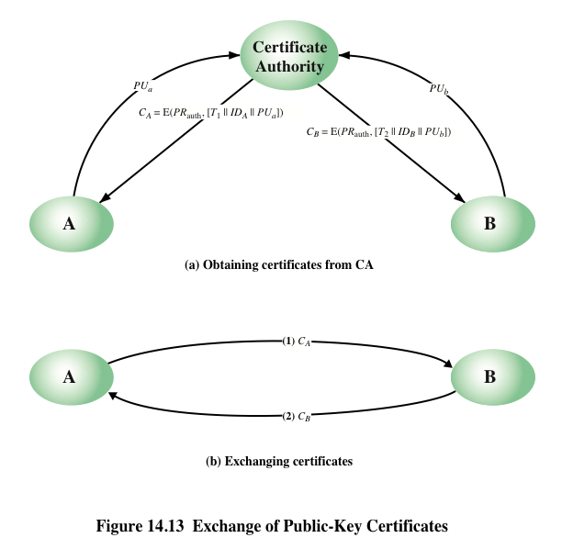
Notes:
The scenario of Figure 14.12 is attractive, yet it has some drawbacks. The public-key
authority could be somewhat of a bottleneck in the system, for a user must appeal
to the authority for a public key for every other user that it wishes to contact. As
before, the directory of names and public keys maintained by the authority is vulnerable
to tampering.
An alternative approach, first suggested by Kohnfelder [KOHN78], is to use
certificates that can be used by participants to exchange keys without contacting a
public-key authority, in a way that is as reliable as if the keys were obtained directly
from a public-key authority. In essence, a certificate consists of a public key, an
identifier of the key owner, and the whole block signed by a trusted third party.
Typically, the third party is a certificate authority, such as a government agency or a
financial institution, that is trusted by the user community. A user can present his or
her public key to the authority in a secure manner and obtain a certificate. The user
can then publish the certificate. Anyone needing this user’s public key can obtain
the certificate and verify that it is valid by way of the attached trusted signature.
A participant can also convey its key information to another by transmitting its
certificate. Other participants can verify that the certificate was created by the
authority. We can place the following requirements on this scheme:
1. Any participant can read a certificate to determine the name and public key of
the certificate’s owner.
2. Any participant can verify that the certificate originated from the certificate
authority and is not counterfeit.
3. Only the certificate authority can create and update certificates.
These requirements are satisfied by the original proposal in [KOHN78]. Denning
[DENN83] added the following additional requirement:
4. Any participant can verify the currency of the certificate.
A certificate scheme is illustrated in Figure 14.13. Each participant applies
to the certificate authority, supplying a public key and requesting a certificate.
Application must be in person or by some form of secure authenticated communication.

Slide 11
X.509 Authentication Service
part of CCITT X.500 directory service standards
distributed servers maintaining user info database
defines framework for authentication services
directory may store public-key certificates
with public key of user signed by certification authority
also defines authentication protocols
uses public-key crypto & digital signatures
algorithms not standardised, but RSA recommended
X.509 certificates are widely used
have 3 versions
Notes:
X.509 is part of the X.500 series of recommendations that define a directory service, being a server or distributed set of servers that maintains a database of information about users.
X.509 defines a framework for the provision of authentication services by the X.500 directory to its users. The directory may serve as a repository of public-key certificates. In addition, X.509 defines alternative authentication protocols based on the use of public-key certificates. X.509 is based on the use of public-key cryptography and digital signatures. The standard does not dictate the use of a specific algorithm but recommends RSA.
The X.509 certificate format is widely used, in for example S/MIME, IP Security and SSL/TLS and SET.
X.509 was initially issued in 1988. The standard was subsequently revised to address some of the security concerns; a revised recommendation was issued in 1993. A third version was issued in 1995 and revised in 2000.

Slide 12
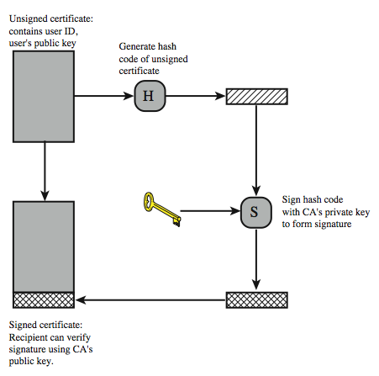
X.509 Certificate Use
Notes:
X.509 is based on the use of public-key cryptography and digital signatures. The standard does not dictate the use of a specific algorithm but recommends RSA. The digital signature scheme is assumed to require the use of a hash function. Again, the standard does not dictate a specific hash algorithm. The 1988 recommendation included the description of a recommended hash algorithm; this algorithm has since been shown to be insecure and was dropped from the 1993 recommendation. Stallings Figure 14.13 illustrates the generation of a public-key certificate.

Slide 13
X.509 Certificates
issued by a Certification Authority (CA), containing:
version V (1, 2, or 3)
serial number SN (unique within CA) identifying certificate
signature algorithm identifier AI
issuer X.500 name CA)
period of validity TA (from - to dates)
subject X.500 name A (name of owner)
subject public-key info Ap (algorithm, parameters, key)
issuer unique identifier (v2+)
subject unique identifier (v2+)
extension fields (v3)
signature (of hash of all fields in certificate)
notation CA<<A>> denotes certificate for A signed by CA
Notes:
The heart of the X.509 scheme is the public-key certificate associated with each user. There are 3 versions, with successively more info in the certificate - must be v2 if either unique identifier field exists, must be v3 if any extensions are used. These user certificates are assumed to be created by some trusted certification authority (CA) and placed in the directory by the CA or by the user. The directory server itself is not responsible for the creation of public keys or for the certification function; it merely provides an easily accessible location for users to obtain certificates. The certificate includes the elements shown, see text for further details.
The standard uses the notation for a certificate of: CA<<A>> where the CA signs the certificate for user A with its private key. In more detail CA<<A>> = CA {V, SN, AI, CA, UCA, A, UA, Ap, TA}. If the corresponding public key is known to a user, then that user can verify that a certificate signed by the CA is valid. This is the typical digital signature approach illustrated in Stallings Figure 13.2.

Slide 14
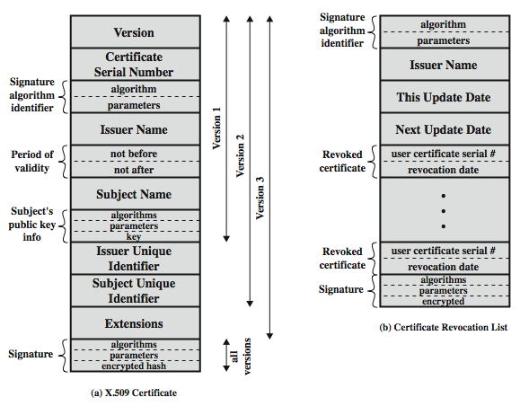
X.509 Certificates
Notes:
Stallings Figure 14.4 shows the format of an X.509 certificate and CRL (see later).

Slide 15
Obtaining a Certificate
User certificates generated by a CA have the following characteristics:
Any user with access to the public key of the CA can verify the user public key that was certified
No party other than the certification authority can modify the certificate without this being detected
Because certificates are unforgeable, they can be placed in a directory without the need for the directory to make special efforts to protect them
In addition, a user can transmit his or her certificate directly to other users
Once B is in possession of A’s certificate, B has confidence that messages it encrypts with A’s public key will be secure from eavesdropping and that messages signed with A’s private key are unforgeable
Notes:
User certificates generated by a CA have the following
characteristics:
• Any user with access to the public key of the CA can verify the user public key
that was certified.
• No party other than the certification authority can modify the certificate without
this being detected.
Because certificates are unforgeable, they can be placed in a directory without the
need for the directory to make special efforts to protect them.
If all users subscribe to the same CA, then there is a common trust of that CA.
All user certificates can be placed in the directory for access by all users. In addition,
a user can transmit his or her certificate directly to other users. In either case,
once B is in possession of A’s certificate, B has confidence that messages it encrypts
with A’s public key will be secure from eavesdropping and that messages signed
with A’s private key are unforgeable.
If there is a large community of users, it may not be practical for all users to
subscribe to the same CA. Because it is the CA that signs certificates, each participating
user must have a copy of the CA’s own public key to verify signatures. This
public key must be provided to each user in an absolutely secure (with respect to
integrity and authenticity) way so that the user has confidence in the associated certificates.
Thus, with many users, it may be more practical for there to be a number
of CAs, each of which securely provides its public key to some fraction of the users.

Slide 16
Certificate Revocation
certificates have a period of validity
may need to revoke before expiry, eg:
user's private key is compromised
user is no longer certified by this CA
CA's certificate is compromised
CA’s maintain list of revoked certificates
the Certificate Revocation List (CRL)
users should check certificates with CA’s CRL
Notes:
A certificate includes a period of validity. Typically a new certificate is issued just before the expiration of the old one.
In addition, it may be desirable on occasion to revoke a certificate before it expires, for one of a range of reasons, such as those shown above.
To support this, each CA must maintain a list consisting of all revoked but not expired certificates issued by that CA, known as the certificate revocation list (CRL). Each certificate revocation list (CRL) posted to the directory is signed by the issuer and includes (as shown in Stallings Figure 14.14b previously) the issuer's name, the date the list was created, the date the next CRL is scheduled to be issued, and an entry for each revoked certificate. Each entry consists of the serial number of a certificate and revocation date for that certificate. Because serial numbers are unique within a CA, the serial number is sufficient to identify the certificate.
When a user receives a certificate in a message, the user must determine whether the certificate has been revoked, by checking the directory CRL each time a certificate is received, this often does not happen in practice.

Slide 17
X.509 Version 3
has been recognised that additional information is needed in a certificate
email/URL, policy details, usage constraints
rather than explicitly naming new fields defined a general extension method
extensions consist of:
extension identifier
criticality indicator
extension value
Notes:
The X.509 version 2 format does not convey all of the information that recent design and implementation experience has shown to be needed. Rather than continue to add fields to a fixed format, standards developers felt that a more flexible approach was needed. X.509 version 3 includes a number of optional extensions that may be added to the version 2 format. Each extension consists of an extension identifier, a criticality indicator, and an extension value. The criticality indicator indicates whether an extension can be safely ignored or not (in which case if unknown the certificate is invalid).

Slide 18
Certificate Extensions
key and policy information
convey info about subject & issuer keys, plus indicators of certificate policy
certificate subject and issuer attributes
support alternative names, in alternative formats for certificate subject and/or issuer
certificate path constraints
allow constraints on use of certificates by other CA’s
Notes:
The certificate extensions fall into three main categories:
key and policy information - convey additional information about the subject and issuer keys, plus indicators of certificate policy. A certificate policy is a named set of rules that indicates the applicability of a certificate to a particular community and/or class of application with common security requirements.
subject and issuer attributes - support alternative names, in alternative formats, for a certificate subject or certificate issuer and can convey additional information about the certificate subject; eg. postal address, email address, or picture image
certification path constraints - allow constraint specifications to be included in certificates issued for CA’s by other CA’s that may restrict the types of certificates that can be issued by the subject CA or that may occur subsequently in a certification chain.

Slide 19
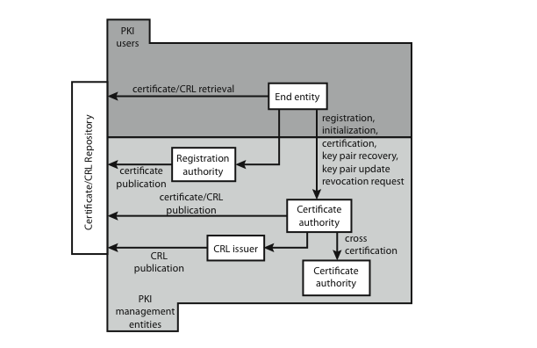
Public Key Infrastructure
Notes:
RFC 2822 (Internet Security Glossary) defines public-key infrastructure (PKI) as the set of hardware, software, people, policies, and procedures needed to create, manage, store, distribute, and revoke digital certificates based on asymmetric cryptography. Its principal is to enable secure, convenient, and efficient acquisition of public keys. The IETF Public Key Infrastructure X.509 (PKIX) working group has setup a formal (and generic) model based on X.509 that is suitable for deploying a certificate-based architecture on the Internet.
Stallings Figure 14.16 shows interrelationships among some key elements:
• End entity: A generic term used to denote end users, devices (e.g., servers, routers), or any other entity that can be identified in the subject field of a public key certificate. End entities canconsume and/or support PKI-related services.
• Certification authority (CA): The issuer of certificates and (usually) certificate revocation lists (CRLs). It may also support a variety of administrative functions, although these are often delegated to Registration Authorities.
• Registration authority (RA): An optional component that can assume a number of administrative functions from the CA. The RA is often associated with the End Entity registration process, but can assist in a number of other areas as well.
• CRL issuer: An optional component that a CA can delegate to publish CRLs.
• Repository: A generic term used to denote any method for storing certificates and CRLs so that they can be retrieved by End Entities.

